Slide 1



Welcome to
Intro to Web
Development
Part B
Instructor: La’Von LaMar Towns

Slide 2


Course Directions
1
2
3
4
5
6
You must view every lesson to pass this ecourse.
You must score 75% or higher to pass this ecourse.
Unanswered questions on any page will be counted wrong.
The certificate page is viewable only if you pass the ecourse.
If you score below 75%, you will be taken back to the title page so you can review the lessons and correct mistakes.
You can stop after any lesson and pick up where you left off later.

Slide 3

Lesson # 1
Getting Started with CSS
Click anywhere on the slide to start the lesson!

Slide 4

Lesson Navigation
Choose what to do next ! Just click a button below !
Video
(Watch it!)
Slides
(Study it!)
Quiz
(Review it!)
Exercise
(Master it!)

Slide 5

Let’s Become a WebDev GURU!
Overview
This class is split into three(3) sections
Each section of this class will conclude with a pop quiz
At the end of this class there will be a class assessment assigned
Notes:
The first rule of training is: Tell them what you’re going to tell them! So take a moment to explain what will be covered in the class.

Slide 6


Stumped?
What exactly is CSS?
How do I use CSS in web development?
Where do I style an anchor tag in CSS?
Notes:
This is an optional slide. It is a wonderful way to loosen people up and engage them early. Just remember when you record the class to say something like, “Proctors please pause the video and take a moment to allow students to guess at the answers to the questions on the screen. The answers will be revealed on the following few slides.”

Slide 7
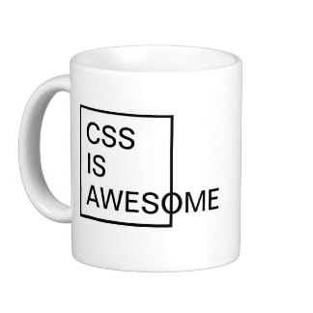
The Fundamentals
CSS is a language used to describe
the appearance of an HTML DOC
Key Notes
CSS stands for Cascade Styling sheet
A style sheet is a file that describes the look of an html doc using css rules
It is called “Cascading” because the sheets can apply formatting when more than one style applies to an element
Notes:
You can add as many information slides as you want after each Section Title slide. The key is variety, variety, variety. Absolutely no one wants to read paragraphs of information on screen after screen. Use graphs, charts, tables, infographics, clipart, videos, and screenshots liberally to liven up your presentation!

Slide 8
Tips
How do we style a web application? There is still a method of going from element to element and styling each in place. Easy, isn't it? Don't do it! Besides that you repeat yourself again and again you will end up with a viscous architecture resisting to any change. Instead you ought to look for repeating patterns in the PSDs and extract reusable components such as navbar, breadcrumbs, dropdowns, thumbnail, panel. Components are supposed to be small and independent. Let's say we have a number of button-like controls across the application. So we create an abstract component identified by class name .btn. The corresponding rule-set describes look & feel applicable to any button in the application
Notes:
Do not skip this slide. Retention goes up dramatically when you remember this one trick: Tell them what you told them!

Slide 9
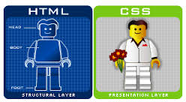
You can also mix clipar with text.
Notes:
If you use a video or screen shot, it will actually fill up the entire screen. I only included the background here in case you use some other form of graphic.

Slide 10
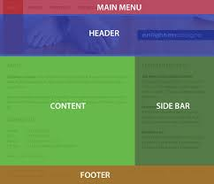
Separating Files??
There are plenty reason a Dev will separate the
two files, But here are a few below
Key Notes
Applying the same format to multiple HTML elements without rewriting code versus inline css where you do rewrite code
Applying the same design/appearance to several HTML pages using just one .css fill
Notes:
You can add as many information slides as you want after each Section Title slide. The key is variety, variety, variety. Absolutely no one wants to read paragraphs of information on screen after screen. Use graphs, charts, tables, infographics, clipart, videos, and screenshots liberally to liven up your presentation!

Slide 11

Things to Style in your stylesheet
HTML IMAGES
HTML LINKS
HTML PARAGRAPHS
HTML HEADINGS
HTML DIVS
HTMLS SPANS
Notes:
Do not skip this slide. Retention goes up dramatically when you remember this one trick: Tell them what you told them!

Slide 12
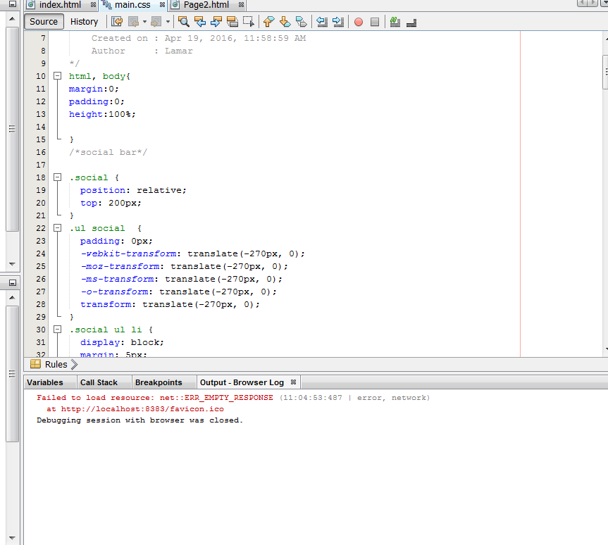
Notes:
If you use a video or screen shot, it will actually fill up the entire screen. I only included the background here in case you use some other form of graphic.

Slide 13
Linking everything together
Now that you know the importance of creating a separate css file, you know that you can also write css inline to your html doc, and you know what css is, lets link the files together
Key Notes
First things first, Always place this link inside the head of you html doc <head></head>
You will need a Type attribute that should always be equal to “text/css”
A rel attribute that should always be equal to “stylesheet”
A HREF attribute that should point to the web address of you CSS file
Notes:
You can add as many information slides as you want after each Section Title slide. The key is variety, variety, variety. Absolutely no one wants to read paragraphs of information on screen after screen. Use graphs, charts, tables, infographics, clipart, videos, and screenshots liberally to liven up your presentation!

Slide 14
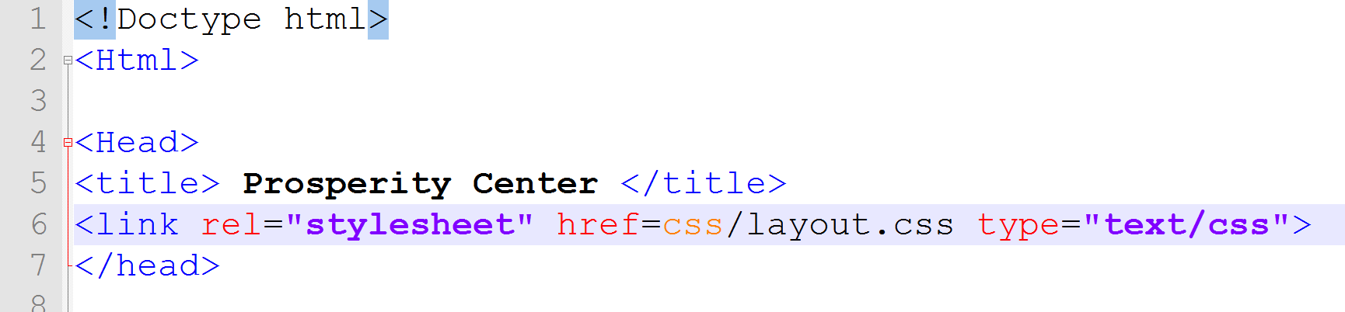
Notes:
If you use a video or screen shot, it will actually fill up the entire screen. I only included the background here in case you use some other form of graphic.

Slide 15
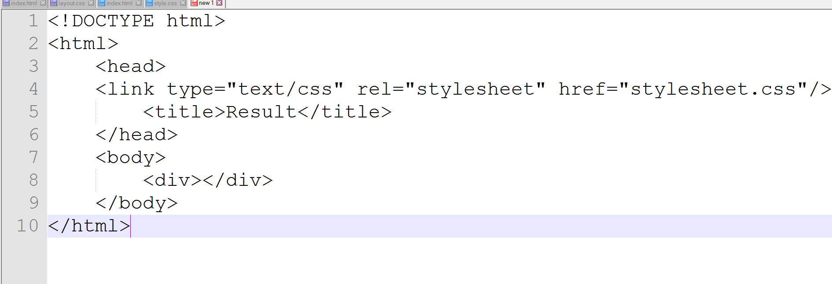
Notes:
Kilobyte is one paragraph of text.
Megabyte is one minute MP3 music track.
Gigabyte is ten yards of books on a shelf.
Terabyte is 250000 MP3 music tracks.
Petabyte is 50 billion pages of text.

Slide 16

Review
What is CSS and what does it stand for?
Where is CSS written?
How would you link Your CSS file to you HTML doc?
Notes:
Do not skip this slide. Retention goes up dramatically when you remember this one trick: Tell them what you told them!

Slide 17
Lesson Exercise
1 Download the exercise file below and open the file.
(you must have Office 2013 on your PC).
2 Step Two
3 Step Three
4 Step Four
5 Step Five

Slide 18
Lesson # 2
CSS SYNTAX * {}

Slide 19
Rules
CSS syntax is created by declaring CSS rules, or simply directions
To style your HTML doc
It’s a 3 step process
A Selector can be any HTML element
A Property is an aspect of an selector, for example Background-color
A Value is a possible setting for a Property, for example Red for Background-color

Slide 20
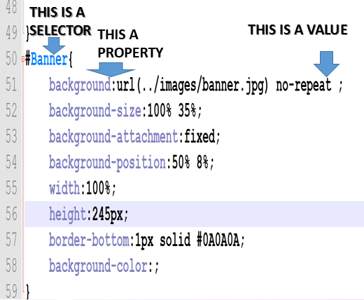

Slide 21
Semicolons
The more property-value pairs you write in your css rules the importance of a semicolon comes into play
More semicolons!
The semicolon tells CSS that one property-value pair is over and its time to start a new one
Without a semicolon your code will not run in the browser
All property-value- pairs and surrounded by curly braces

Slide 22
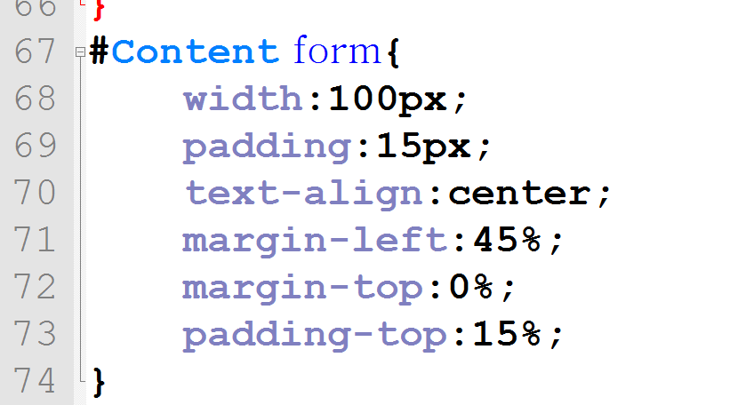
NOTICE THE SEMICOLONS????

Slide 23
Comments
A good programmer always leaves bread crumbs. Save a life a leave a comment
Comments help remind you why you did something a certain way
/* I am a comment in css unlike in HTML where it would look like this < !- - -html- - ->*/.
Remember that its always ok to write clear and concise comments without worry that the cpu will read it and it end up on the front end browser
Notes:
Do not skip this slide. Retention goes up dramatically when you remember this one trick: Tell them what you told them!

Slide 24
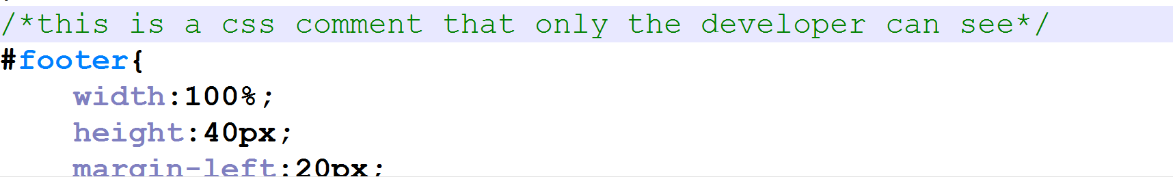
Not quite like HTML, or is it ?

Slide 25
Review
We Create a CSS rule by giving an element an ___ and ___fill in the blank)
Will you CSS rules “run” without a semicolon?
Why do we “comment” in CSS
Notes:
Kilobyte is one paragraph of text.
Megabyte is one minute MP3 music track.
Gigabyte is ten yards of books on a shelf.
Terabyte is 250000 MP3 music tracks.
Petabyte is 50 billion pages of text.

Slide 26
Lesson Navigation
Study the way you learn best ! Play the video. Review the slides. Or do both. Just click a button below to begin !
Video
(Watch it!)
Slides
(Study it!)
Quiz
(Review it!)
Exercise
(Master it!)

Slide 27

You Got This!
Lesson Quiz!
Click the slide to start the quiz!

Slide 28

Lesson Exercise
1 Download the exercise file below and open the file.
(you must have Office 2013 on your PC).
2 Step Two
3 Step Three
4 Step Four
5 Step Five

Slide 29

Lesson # 3
Details of CSS

Slide 30
Lesson Navigation
Choose what to do next ! Just click a button below !
Video
(Watch it!)
Slides
(Study it!)
Quiz
(Review it!)
Exercise
(Master it!)

Slide 31
Hexadecimal values
You can easily change something like the color of an element simply by stating color:red; or you can be a CSS guru and use hex values
Keynotes
Css understand millions of colors in the form of HEXADECIMAL VALUES
UNLIKE DECIMAL VALUES, HEXADECIMAL VALUES base-16 counting because you use all real numbers 0-9 and letters A-F
Notes:
Kilobyte is one paragraph of text.
Megabyte is one minute MP3 music track.
Gigabyte is ten yards of books on a shelf.
Terabyte is 250000 MP3 music tracks.
Petabyte is 50 billion pages of text.

Slide 32
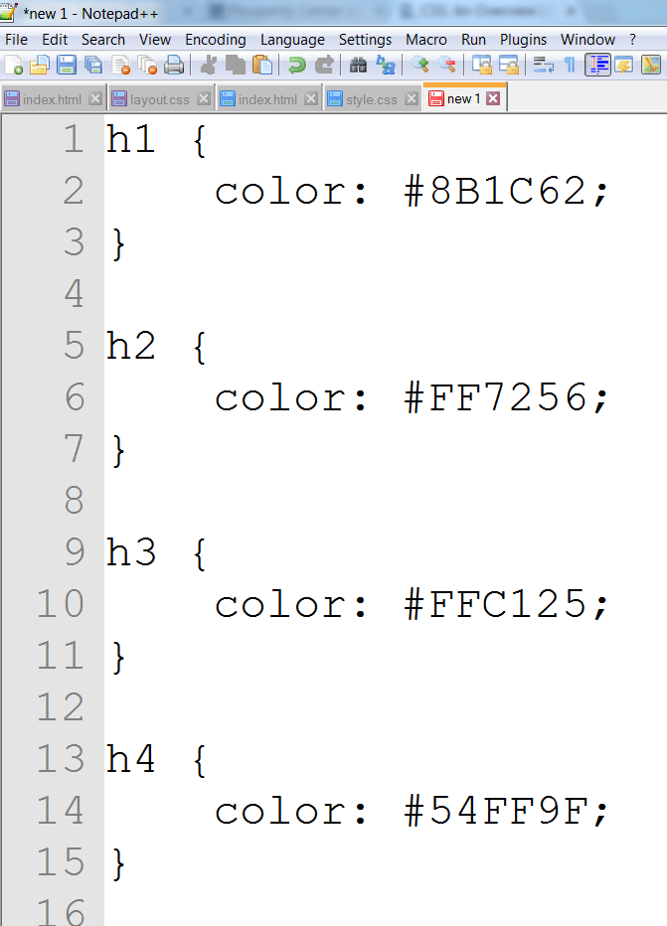
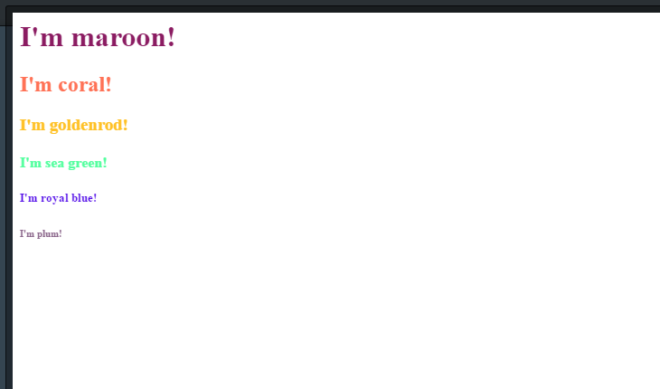
Notes:
Kilobyte is one paragraph of text.
Megabyte is one minute MP3 music track.
Gigabyte is ten yards of books on a shelf.
Terabyte is 250000 MP3 music tracks.
Petabyte is 50 billion pages of text.

Slide 33
Pixels vs Ems
A pixel is a dot on your cpu screen and is great when you want a user to see on their screen exactly what you see on yours assuming you have the same screen
The font-size em is a relative measure meaning one em unit is equal to the default font size on whatever screen is using
2em would be twice that size and 0.5em would be half that size
Notes:
Do not skip this slide. Retention goes up dramatically when you remember this one trick: Tell them what you told them!

Slide 34
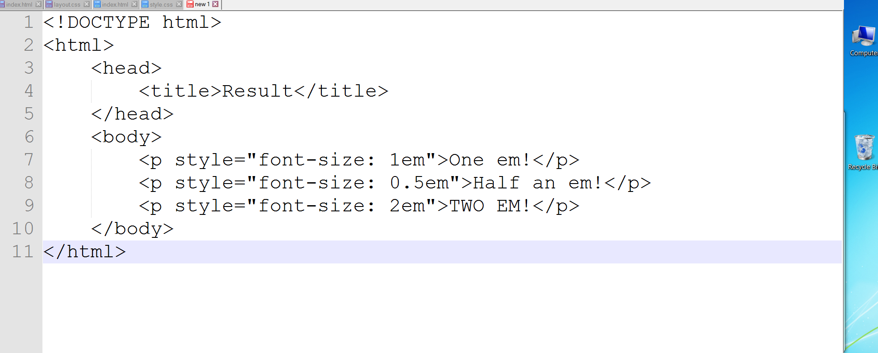
Notes:
Kilobyte is one paragraph of text.
Megabyte is one minute MP3 music track.
Gigabyte is ten yards of books on a shelf.
Terabyte is 250000 MP3 music tracks.
Petabyte is 50 billion pages of text.

Slide 35
Fonts!
CSS has some built-in default fonts meant to ensure your users see what you intend on them to see
Pull out the “FONTS”!!!!
Serif- A font with little decoration.
Sans-Serif- A Plain font
Cursive- The fancy script type font
Notes:
Kilobyte is one paragraph of text.
Megabyte is one minute MP3 music track.
Gigabyte is ten yards of books on a shelf.
Terabyte is 250000 MP3 music tracks.
Petabyte is 50 billion pages of text.

Slide 36
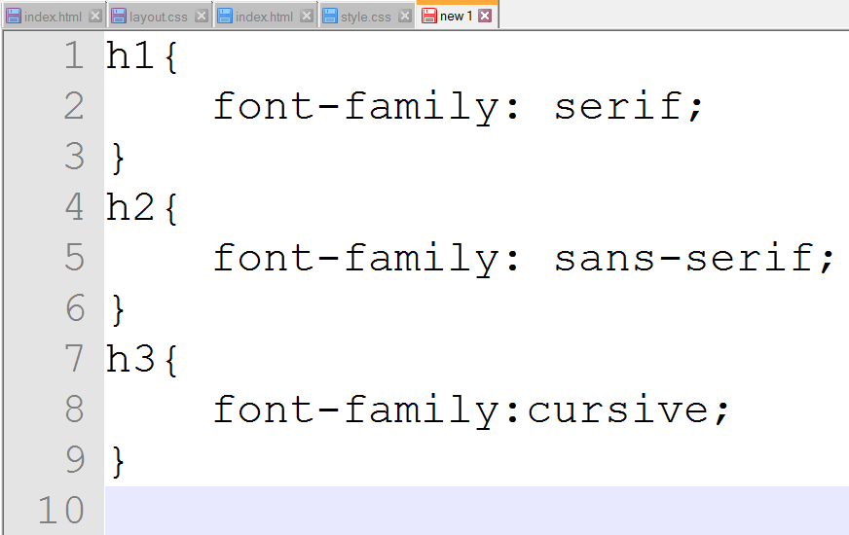
Notes:
Kilobyte is one paragraph of text.
Megabyte is one minute MP3 music track.
Gigabyte is ten yards of books on a shelf.
Terabyte is 250000 MP3 music tracks.
Petabyte is 50 billion pages of text.

Slide 37
Background color Height
and Weight
You can easily change something like the color of an element simply by stating color:red; or you can be a CSS guru and use hex values
Keynotes
Background-color is an attribute you can apply to an HTML element and it is set by hexadecimal values or colors
Height is an attribute you can apply to an HTML element and it is measure in pixels
Notes:
Kilobyte is one paragraph of text.
Megabyte is one minute MP3 music track.
Gigabyte is ten yards of books on a shelf.
Terabyte is 250000 MP3 music tracks.
Petabyte is 50 billion pages of text.

Slide 38
Borders
Pretty much all HTML elements support the border property
Keynotes
The border property supports several values
You are able to describe the thickness of a border
You are able to describe weather the border line is solid or not
You can also describe the color of the border
Notes:
Kilobyte is one paragraph of text.
Megabyte is one minute MP3 music track.
Gigabyte is ten yards of books on a shelf.
Terabyte is 250000 MP3 music tracks.
Petabyte is 50 billion pages of text.

Slide 39
You Got This!
Lesson Quiz!
Click the slide to start the quiz!

Slide 40
Lesson Exercise
1 Download the exercise file below and open the file.
(you must have Office 2013 on your PC).
2 Step Two
3 Step Three
4 Step Four
5 Step Five

